Slide 1
706 Snowy Owl Squadron Ground School Program
CI Joseph Augé

Slide 2
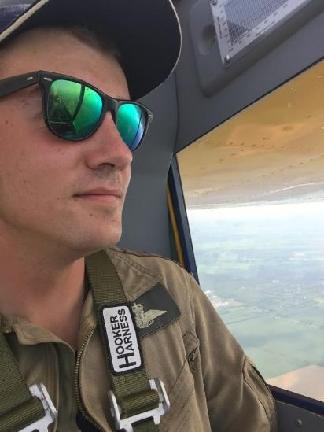
About Me
Qualified Glider Instructor
Power Pilot
In 706 since 2011
Undergrad BComm(Hons) Algonquin College

Slide 3
Course Structure
Mid-October to first week of February
10h00-13h00
Structured towards seniors, open to all

Slide 4
Materials
Pens/paper
Cadet Flying Study Guide
$25-30 to cover printing
Includes all material from course

Slide 5
Sample Topics
Air Law
Navigation
Radio
Engines
Meteorology
Theory of Flight
Human Factors
Flight Operations

Slide 6
Course Structure
Subject test one week after each subject
Marks only count for scholarship applicants
Practice interviews and exams once all content is complete

Slide 7
Glider Pilot Scholarship
Saint-Jean-sur-Richelieu, QC
6 weeks, Monday-Saturday flying
Trained by Transport Canada certified Cadet Officer Glider Instructors
Transport Canada Glider Pilot License ($15,000 value incl. room and board)

Slide 8
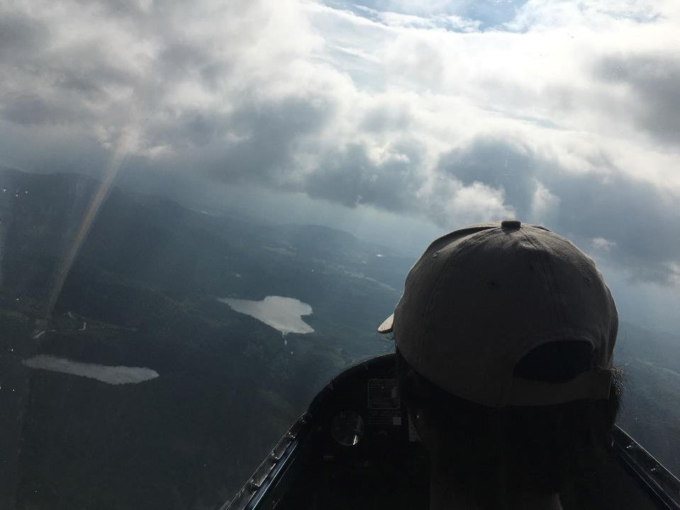

Slide 9
Power Pilot Scholarship
Flight schools across Quebec
7 weeks, Monday-Saturday flying
Trained by Commercial Pilot instructors
Transport Canada Private Pilot License ($20,000 value incl. room and board)

Slide 10
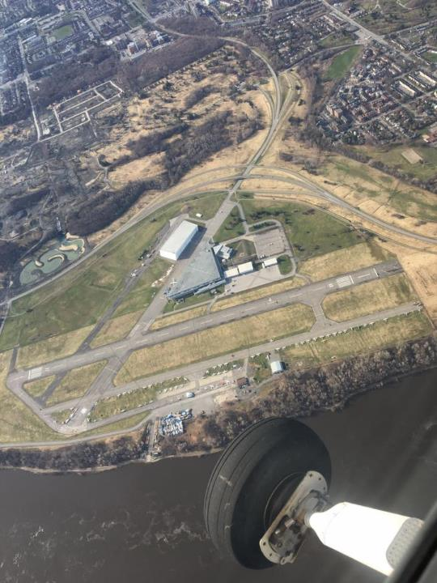

Slide 11
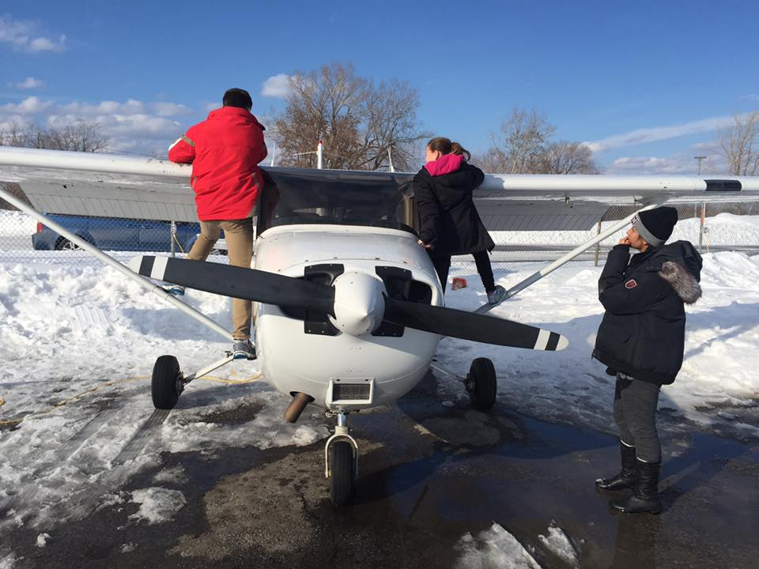

Slide 12
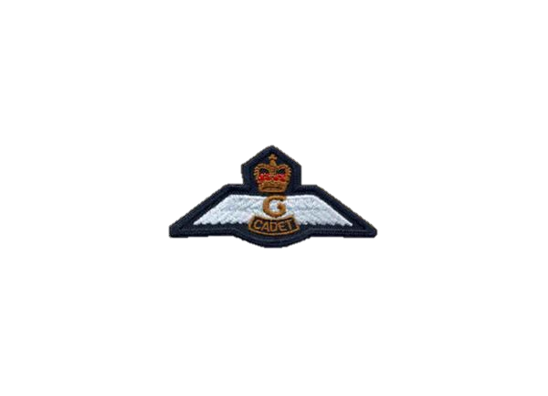
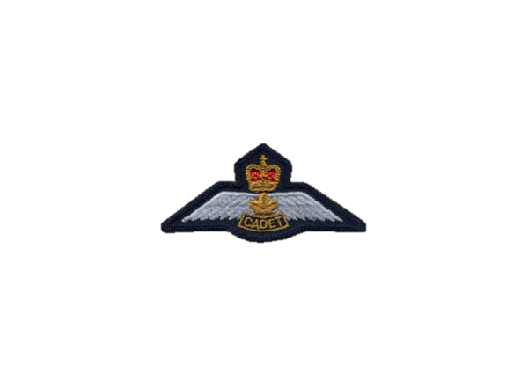
Eligibility Requirements
Glider Pilot Scholarship
Minimum 16 years old by Sept 1st, 2019
Grade 9 completed
Level 3 completed by end of training year
Power Pilot Scholarship
Minimum 17 years old by Sept 1st, 2019
Grade 10 completed
Level 4 completed by end of training year

Slide 13
League Application Matrix
Entrance Exam (30%)
Interview (30%)
School Grades, previous year (20%)
Cadet career (20%)
Mandatory/Optional Attendance
Previous Awards, Summer Camps attended
Rank/Position in squadron

Slide 14
Rank /5 5-WO, 4-FSgt, 3-Sgt, 2-FCpl, 1-Cpl
Mandatory Attendance /20 System Generated
Optional Attendance /5 3-recurring activity, 0.5-any other
Uniform Inspection /5 % year to date
Previous Awards /5 1pt each
Camps Attended /5 1-2 or 3 weeks, 2-6 weeks
School Marks /10 Previous academic year average
Ground School /15 Average on Ground School evaluations
Deductions case by case

Slide 15
Aviation Medical
Required before March 1st, 2019
Costs from $125-175
5 year validity for persons under 40
Must ask for Class 3 Aviation Medical
Only from Certified Aviation Medical Examiners

